Slide 1
Designing for MongoDB

Slide 2

Case Study
We will introduce a case study here.
We will use this to think about examples on the topic.
The .csv is in the MongoDB folder in your sidebar.
Notes:
http://openflights.org/data.html
As of January 2017, the OpenFlights Airports Database contains over 10,000 airports, train stations and ferry terminals spanning the globe. Each entry contains the following information:
Airport ID Unique OpenFlights identifier for this airport.
Name Name of airport. May or may not contain the City name.
City Main city served by airport.
Country Country or territory where airport is located.
IATA_FAA 3-letter IATA code. Null if not assigned/unknown.
ICAO 4-letter ICAO code. Null if not assigned.
Latitude Decimal degrees, to six significant digits. -ive is S, +ive is N.
Longitude Decimal degrees to six significant digits. -ive is W, +ive is E.
Altitude_FT In feet.
Timezone Hours (or fractions of them) offset from UTC.
DST Daylight savings time. One of E (Europe), A (US/Canada), S (South America), O (Australia), Z (New Zealand), N (None) or U (Unknown).
This data may not be perfect. How would we check it for accuracy?
Are there any IATA_FAA codes that apply to > 1 airport?
Are there any ICAO codes that apply to > 1 airport?
How many airports are in London?
Is that London in the UK?
Airlines as well as railway, bus and ferry companies, computer reservations systems (CRSs) and ULD owners/leasing companies may be assigned an IATA two character designator code.
International Civil Aviation Organization airport code or location indicator is a four-character alphanumeric code designating aerodromes around the world.

Slide 3
Document
A set of key-value pairs.
Documents have dynamic schema.
Documents in the same collection do not need to have the same set of fields or structure, and common fields in a collection's documents may hold different types of data.
Each document in a collection is uniquely identified by a 12 byte hexadecimal number (_id)
can be provided while inserting the document.
Generated if not provided

Slide 4
Sample documents
Profile collection:
{ name: “Isaac Newton”,
lived: “(1642 – 1726)”,
speciality: [“mathematics”, “optics”, “physics”, “astronomy”],
famous_for: “Principia Mathematica”}, {name: “Marie Curie”,
nationality: “Polish”,
speciality: [”Chemistry”, “Physics”],
lived: “(1867 - 1934)”,
famous_for: “Nobel Prize in Chemistry and Physics”}, {name: ”Albert Einstein”,
lived: “(1879 – 1955)”,
specialty:[“Mathematics”, “Physics”],
famous_for: “Nobel Prize in Physics”}

Slide 5
A sample document
In a student collection:
{ _id:”C12345678”,
sname: ”Joe Bloggs”, prog_code: “DT228”, acad_history: [ {year: “2012”, stage: “1”, outcome: “Progress”},
{year: “2013”, stage: “2”} ], email: “C12345678@mydit.ie”}
The _id can be provided, but if it is not, it will be generated. It is always called _id
The acad_history attribute is an array of history over the years.
The array is named and enclosed in square brackets.
Inside the brackets is either:
A series of values, separated by commas or
key-value pairs.
It doesn’t matter if fields are missing

Slide 6
3 ways to model 1:many
what is the cardinality of the relationship?
Is the “One-to-N” relationship
“one-to-few”
“one-to-many” or
“one-to-squillions”?
Squillion - An indefinite very large number (informal)
Oxford English Dictionary

Slide 7
One-to-Few - embedding
Embed the ‘many’ in the ‘one’.
Advantages:
A single query returns the entire document, including the embedded details;
Disadvantage:
Accessing embedded details as stand-alone entities is complex.

Slide 8
Good example
e.g. addresses for a person; put the addresses in an array inside the Person object:
{
name: 'Kate Monster',
ssn: '123-456-7890',
addresses : [
{ street: '123 Sesame St', city: 'Anytown', cc: 'USA' },
{ street: '123 Avenue Q', city: 'New York', cc: 'USA' }
]

Slide 9
Bad example
To model a task-tracking system, each Person has a number of Tasks assigned to them.
{
name: 'Kate Monster',
ssn: '123-456-7890',
tasks : [
{ task: ’Interview salespeople', project: ’Sales App', co: 'ACME'},
{ task: ’Interview MD', project: ’Fin. accounting', co: 'MongoBank' },
{ task: ’Prepare feasibility report', project: ’Sales App', co: 'ACME'}]
}
If Tasks are embedded inside the Person document queries such as “Show me all Tasks for the company ACME” would be tricky. NOTE: This is only significant if that is a query that is required.

Slide 10
Question Time
Notes:
On the pobyrne schema on Redwood there it a table called AIRPORTS, downloaded from the Internet. The list is one that has been made up by multiple users and has some errors in it. It contains
desc airport. Design a collection that represents each city embeds the airports in it. What do you need to know?
Name Null Type
----------- ---- ------------
AIRPORTID NUMBER(4)
NAME VARCHAR2(70)
CITY VARCHAR2(39)
COUNTRY VARCHAR2(32)
IATA_FAA CHAR(3)
ICAO VARCHAR2(4)
LATITUDE VARCHAR2(12)
LONGITUDE VARCHAR2(12)
ALTITUDE_FT VARCHAR2(5)
TIMEZONE VARCHAR2(5)
DST CHAR(1)
If we want to group these, using 1:few, what groupings could we do?

Slide 11
One-to-Many - referencing
i.e. not 1:few and not 1:squillions.
Each master document can have up to around 2 thousand detail documents.
Referencing – put the ObjectIds (_id) of the detail document in an array in the master document.
This is good if there is quite a bit of information being embedded and it is sometimes retrieved on its own (i.e. not as part of the full document).

Slide 12
Good example
parts for a product in a replacement parts ordering system
1 product : up to several hundred parts

Slide 13
Part document
Part document (in the part collection)
db.part.insert([{
partno: '123-aff-456',
name: '#4 grommet',
qty: 94,
cost: 0.94,
price: 3.99
}
>db.part.find({partno: '123-drm-456'}).pretty()
{
"_id" : ObjectId("582485ade8d74ccf062685b0"),
"partno" : "123-drm-456",
"name" : "Door moulding",
"qty" : 70.0,
"cost" : 4.0,
"price" : 9.99
}
Syntax such as the use of quotes and braces can change depending on the tool being used as the front-end and the style of the designer.
The objectId is a12-byte value:
4-byte - seconds since Unix epoch
3-byte machine identifier,
2-byte process id
3-byte counter, starting with a random value.
We can use js to get an array of the part object ids:
part_array = db.part.find({},{ObjectId:1}).toArray()

Slide 14
Product document
Each Product has a document containing an array of ObjectId references to the Parts that make up that Product:
db.products.insert({ name: 'Left-handed smoke shifter', manufacturer: 'ACME Corp', catalog_number: 1234, parts:[ part_array[0]._id, //or ObjectId(“1234…abc”) part_array[2]._id ] })
Notes:
use OneMany
db.part.drop()
db.createCollection("part")
db.part.insert([{
partno: '123-aff-456',
name: '#4 grommet',
qty: 94,
cost: 0.94,
price: 3.99
},
{
partno: '123-aff-457',
name: '#4 washer',
qty: 30,
cost: 0.34,
price: 1.99
},
{
partno: '123-drm-456',
name: 'Door moulding',
qty: 70,
cost: 4,
price: 9.99
}
])
//db.part.find({partno: '123-drm-456'}).pretty()
part_array = db.part.find({},{ObjectId:1}).toArray()
part1 = part_array[0]._id
part2 = part_array[2]
//product_parts = db.part.find({ _id: { $in : product.parts }}).toArray()
db.products.drop()
db.createCollection("products")
db.products.insert({
name: 'Left-handed smoke shifter',
manufacturer: 'ACME Corp',
catalog_number: 1234,
parts:[
part_array[0]._id,
part_array[2]._id
// hard coded from query above)
]
})
db.products.find()
product = db.products.findOne({catalog_number: 1234})
product_parts = db.part.find({ _id: { $in : product.parts }},{"_id":0,"name":1}).toArray()

Slide 15
Retrieving parts for a product
An application-level join retrieves the parts for a particular product:
// Fetch the Product identified by this catalog number
> product = db.products.findOne({catalog_number: 1234});
// Fetch all the Parts that are linked to this Product
product_parts = db.parts.find({_id: { $in : product.parts } } ).toArray() ;
For efficient operation, an index on ‘products.catalog_number’ is required.
Note that there will always be an index on ‘parts._id’, so that query will always be efficient.
db.products.createIndex({catalog_number: 1})
Notes:
db.part.find({},{ObjectId:1})
db.products.drop()
db.createCollection("products")
db.products.insert({
name: 'Left-handed smoke shifter',
manufacturer: 'ACME Corp',
catalog_number: 1234,
parts:[
ObjectId('58248b98e8d74ccf062685bd'),
ObjectId('58248b98e8d74ccf062685be'),
ObjectId('58248b98e8d74ccf062685bf')]
})
product = db.products.findOne({catalog_number: 1234})
product_parts = db.part.find({ _id: { $in : product.parts }}).toArray()

Slide 16
Using references
Advangtages
Each Part is a stand-alone document, so it’s easy to search them and update them independently.
Many parts can be used by many products - no weak entity required.
Disadvantage
A second query is required to get details about the Parts for a Product.

Slide 17
One-to-Squillions
Some data arrangements could have a huge number of rows related to just one master document
e.g. an event logging system that collects log messages for different machines.

Slide 18
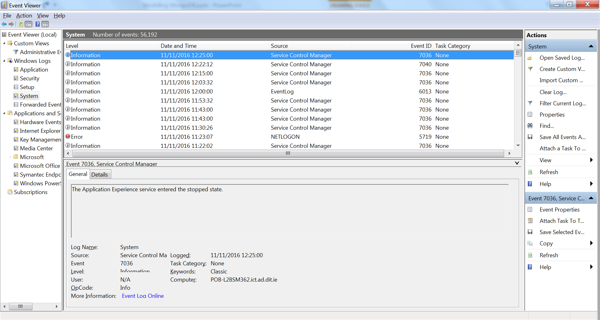
Event viewer (Dell laptop)

Slide 19
Parent referencing
If the event is referenced in an array in the master (machine), just 1 document could generate enough messages to overflow the 16 MB maximum document size, even if just the ObjectId was stored in the array.
parent-referencing – one document for the host, and store the ObjectId of the host in the documents for the log messages.

Slide 20
Parent-referencing
> db.hosts.findOne()
{
_id : ObjectId('AAAB'),
name : 'goofy.example.com',
ipaddr : '127.66.66.66'
}
>db.logmsg.findOne()
{
time : ISODate("2014-03-28T09:42:41.382Z"),
message : 'cpu is on fire!',
host: ObjectId('AAAB') // Reference to the Host document
}
See code on webcourses – this won’t run.

Slide 21
Find the messages
Use an application-level join to find the most recent 5,000 messages for a host:
// find the parent ‘host’ document
host = db.hosts.findOne({ipaddr : '127.66.66.66'});
// assumes unique index
// find the most recent 5000 log message documents linked to that host
> last_5k_msg = db.logmsg .find({host: host._id}) .sort({time : -1}) .limit(5000).toArray()

Slide 22
Recap
Consider two factors:
Will the entities on the “N” side of the One-to-N ever need to stand alone?
What is the cardinality of the relationship: is it one-to-few; one-to-many; or one-to-squillions?
Then pick one of the three basic One-to-N schema designs:
Embed the N side if the cardinality is one-to-few and there is no need to access the embedded object outside the context of the parent object
Use an array of references to the N-side objects if the cardinality is one-to-many or if the N-side objects should stand alone for any reasons
Use a reference to the One-side in the N-side objects if the cardinality is one-to-squillions

Slide 23
Two-way referencing and denormalization
Available at :
http://blog.mongodb.org/post/87892923503/6-rules-of-thumb-for-mongodb-schema-design-part-2

Slide 24
Two-Way Referencing
It is possible to have both
References from the “one” side to the “many” side and
references from the “many” side to the “one” side.
e.g. task-tracking system.
A “people” collection holds Person documents,
A “tasks” collection holding Task documents,
Person:Task is 1:Many
The application tracks all of the Tasks owned by a Person, so needs to reference Person -> Task.

Slide 25
Person document
With, a single Person document might have an array of references to Task documents:
db.person.findOne()
{
_id: ObjectId("AAF1"),
name: "Kate Monster",
tasks [ // array of references to Task documents
ObjectId("ADF9"),
ObjectId("AE02"),
ObjectId("AE73")
// etc
]
}

Slide 26
The tasks
Sometimes the application needs to display which Person is responsible for each Task.
Optimize this by putting an additional reference to the Person in the Task document.
db.tasks.findOne()
{
_id: ObjectId("ADF9"),
description: "Write lesson plan",
due_date: ISODate("2014-04-01"),
owner: ObjectId("AAF1") // Reference to Person document
}

Slide 27
Discussion
This design has all of the advantages and disadvantages of the 1:many schema, but with some additions.
Putting in the extra ‘owner’ reference into the Task document means that its quick and easy to find the Task’s owner☺
But it also means that to reassign the task to another person, two updates are required instead of just one. ☹
Specifically, both the reference from the Person to the Task document, and the reference from the Task to the Person need to be updated.

Slide 28
PROBLEM
Using this schema design means that it is no longer possible to reassign a Task to a new Person with a single atomic update.
This is OK for this task-tracking system: BUT whether this works for a particular use case is a major design consideration.

Slide 29
Denormalizing 1:many
Denormalization can be added into any schema.
Eliminates some application-level joins
Adds some additional complexity when performing updates.

Slide 30
Denormalizing (Many:1)
For the parts example, the name of the part could go into the ‘parts[]’ array.
For reference, here’s the version of the Product document without denormalization.
> db.products.findOne()
{
name : 'left-handed smoke shifter',
manufacturer : 'Acme Corp',
catalog_number: 1234,
parts : [ // array of references to Part documents
ObjectId('AAAA'), // reference to the #4 grommet above
ObjectId('F17C'), // reference to a different Part
ObjectId('D2AA'),
// etc
]
}

Slide 31
Denormalized
To retrieve the name – no join!
To retrieve any other product information, a join is required.
> db.products.findOne()
{
name : 'left-handed smoke shifter',
manufacturer : 'Acme Corp',
catalog_number: 1234,
parts : [
{ id : ObjectId('AAAA'), name : '#4 grommet' }, // Part name denormalized
{ id: ObjectId('F17C'), name : 'fan blade assembly' },
{ id: ObjectId('D2AA'), name : 'power switch' },
// etc
]
}

Slide 32
Denormalizing
This makes it easier to get the part names
It adds client-side work to the application-level join:
// Fetch the product document
> product = db.products.findOne({catalog_number: 1234});
// Create an array of ObjectId()s containing *just* the part numbers
> part_ids = product.parts.map( function(doc) { return doc.id } );
// Fetch all the Parts that are linked to this Product
> product_parts = db.parts.find({_id: { $in : part_ids } } ).toArray() ;

Slide 33
Discussion
Denormalizing saves a lookup of the denormalized data at the cost of a more expensive update:
If the Part name was put into the Product document, then every update of the Part name requires an update every place it occurs in the ‘products’ collection.
Assume the part name changes infrequently, but the quantity on hand changes frequently.
it makes sense to denormalize the part name into the Product document,
it does not make sense to denormalize the quantity on hand.

Slide 34
When to denormalize
DO:
When there’s an high ratio of reads to updates.
As updates become more frequent relative to queries, the savings from denormalization decrease.
BUT:
The ability to perform atomic and isolated updates on that field is lost.
After the part name is updated in the Part document, and before / while it is updated in the Product document, the denormalized ‘name’ in the Product document will not reflect the new, updated value in the Part document.

Slide 35
Recap
Bi-directional referencing can be used to optimize a schema, if atomic updates are not important
Data can be denormalized either from the “One” side into the “N” side, or from the “N” side into the “One” side
When deciding whether or not to denormalize, consider the following factors:
atomic updates cannot be performed on denormalized data
Denormalization only makes sense when there is a high read to write ratio

